Slide 1

Nutrition
Chapter 12

Slide 2
Nutrition and Global Health
12.1

Slide 3
The Nutrition Transition
Nutrition = the consumption and processing of foods that allow the body to survive, grow, heal, and be healthy.
Nutrition transition = the shift from having undernutrition and nutrient deficiencies as the most prevalent nutritional concerns to having overweight and obesity as the dominant nutritional disorders.

Slide 4
The Nutrition Transition (cont’d)
Lowest-income communities tend to have too little food.
  International cooperation is required in order to ensure food safety in an era of increased globalization of the food supply.
During the transition, countries often experience a dual burden of nutritional problems, with undernutrition continuing to be prevalent among children (especially those living in rural areas or in low-income urban communities) while adult obesity becomes more common.
High- and middle-income communities have rising rates of obesity.
  Obesity is related to many chronic diseases (like diabetes and hypertension).

Slide 5
Macronutrients
12.2

Slide 6
Macronutrients
Macronutrients = nutrients such as carbohydrates, protein, and fats and oils that are required to be consumed in relatively large quantities because they provide energy.
Energy in food is typically measured in units of calories.
  One calorie of food (which is technically 1 kilocalorie, which is why the units for food energy measurements are sometimes reported in as units of “kcal”) is equal to the amount of energy required to raise the temperature of 1 gram of water by 1 degree Celsius.
The number of calories needed by a person each day varies based on age, sex, body size, activity level, climate, and pregnancy and lactation status.
  In higher-income countries, the number of calories available far exceeds the required number.
  Some low-income countries struggle to produce or import enough food.

Slide 7
Carbohydrates
Carbohydrates = saccharides = chains of sugars.
Fiber = a non-digestible complex carbohydrate found in unprocessed plant-based foods.
Nutritionists recommend that for most people 45% to 65% of calories taken in over a day should come from carbohydrates.
  In low-income countries, many people eat a starchy diet that exceeds this recommended proportion.

Slide 8
Proteins
Amino acids = organic compounds that contain carbon, hydrogen, oxygen, and nitrogen.
Proteins = chains of amino acids.
About 20 different kinds of amino acids are recognized as critical for human biochemistry.
  Essential amino acids = amino acids that humans must acquire from food.
Complete proteins = foods that contain all of the essential amino acids.
Complementary proteins = combinations of foods that provide all of the amino acids in one meal.
Nutritionists generally recommend that for most people 10% to 35% of daily calories should come from high-quality proteins.

Slide 9
Fats
Lipids = fatty acids = hydrocarbon chains with other chemical groups at the ends of the chains.
Fats = lipids of animal origin like butter and lard that are solid at room temperature.
Oils = lipids of plant origin like corn oil and olive oil that are liquids at room temperature.
Lipids contain more energy per gram than any other biological molecule and provide long-term energy storage, insulation, protective padding around internal organs, and assistance with nutrient absorption.
Nutritionists recommend that about 20% to 35% of calories consumed in a day should come from healthy fats and oils.

Slide 10
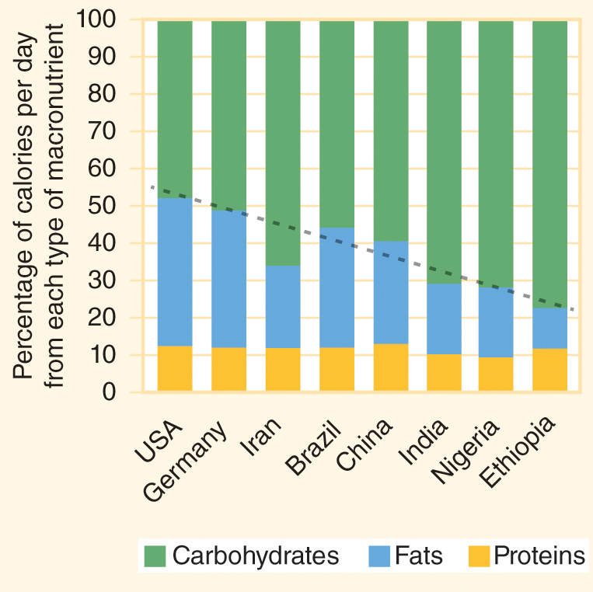
Figure 12-1
Data from FAOSTAT food balance sheets 2013. Rome: Food and Agriculture Organization of the United Nations; 2015.
People living in higher-income countries eat more fats and fewer carbohydrates than people living in lower-income countries.

Slide 11
Fats (cont’d)
The relative healthiness of lipids is often related to the amount of hydrogen they contain.
Unsaturated fatty acids contain at least one double bond in the carbon chain, and they seem to be protective against heart disease.
Saturated fatty acid are molecules that are “saturated” with hydrogen, with only single bonds between its carbon atoms.
Trans fats are liquid oils that have been transformed into solid fats by adding hydrogen to them through the use of pressure; they have been shown to raise “bad” (or “lousy”) LDL (low-density lipoprotein) cholesterol in the body while depleting “good” (or “healthy”) HDL (high-density lipoprotein) cholesterol.

Slide 12
Water
Water is not a nutrient but is an essential part of the diet.
Blood, which is about 92% water, is the medium for transporting gases, nutrients, and wastes throughout the body.
An adult loses about 2 to 3 quarts of water a day by urinating, sweating, and exhaling humidified air, and this lost water must be replaced to avoid dehydration.

Slide 13
Protein-Energy Malnutrition
12.3

Slide 14
Undernutrition
Undernutrition = malnutrition resulting from deficiencies in the amount of food or types of nutrients eaten, or from poor absorption of the nutrients that have been consumed.
At least one in five deaths of under-5 children can be attributed to undernutrition.
  Even mild and moderate undernutrition can significantly increase a child’s risk of illness and death due to diarrhea, acute respiratory infections, malaria, and measles.
The SDGs aim to “end hunger and ensure access by all people, in particular the poor and people in vulnerable situations, including infants, to safe, nutritious and sufficient food all year round” (SDG 2.1) and to “end all forms of malnutrition” by achieving growth targets in children under 5 years of age and also addressing “the nutritional needs of adolescent girls, pregnant and lactating women, and older persons” (SDG 2.2).

Slide 15
Anthropometry
Anthropometry = the measurement of the human body.
  Height, weight, waist circumference, body fat percentage, and other measurements.
Stunting = a child with low height-for-age, an indicator of chronic malnutrition.
Wasting = a child with low weight-for-height (also called weight-for-length), a sign of acute malnutrition characterized by rapidly decreasing nutritional health status.
Underweight = a child with low weight-for-age.

Slide 16
Growth Standards
Global growth standards for children from birth through 60 months are provided by the World Health Organization.
Since the distribution of anthropometric measurements follows a normal (bell-shaped) curve, these percentiles can be translated to z-scores.
  A standard deviation is a statistical indicator for the width of a distribution, and a z-score is an indicator of how many standard deviations away from the mean an individual’s measure is.

Slide 17
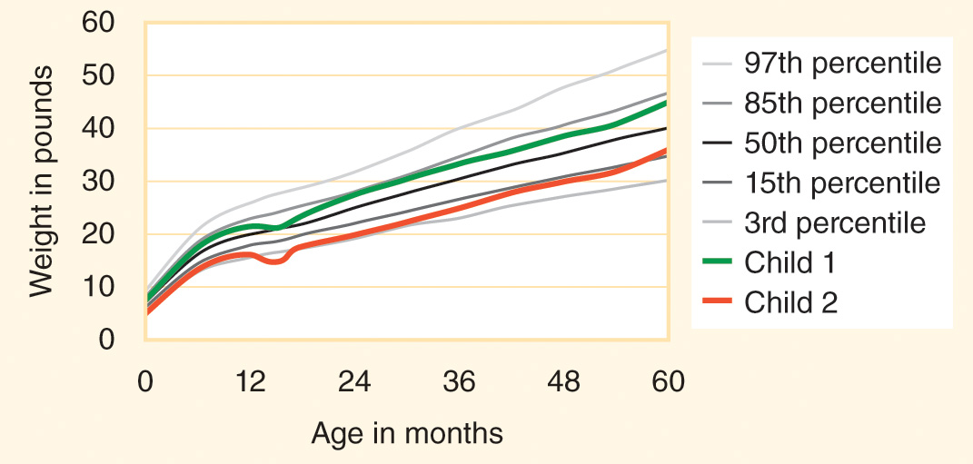
Figure 12-2
Data from WHO Multicentre Growth Reference Study Group. WHO child growth standards: length/height-for-age, weight-for-age, weight-for-length, weight-for-height and body mass index-for-age: methods and development. Geneva World Health Organization; 2006.
A sample child growth chart showing weight-for-age for two girls from birth to age 5.

Slide 18
SAM and PEM
Severe acute malnutrition (SAM) = a child with a weight-for-height z-score below –3, a condition requiring urgent medical care.
  Mid-upper arm circumference (MUAC) is another indicator of wasting, and children with a MUAC of less than 11.5 centimeters have SAM.
Protein energy malnutrition (PEM) = a severe form of chronic undernutrition that presents in two different forms.
  Marasmus = children who are emaciated, weak, and lethargic because of long-term calorie deprivation.
  Kwashiorkor = children lacking protein in the diet who develop edema, fluid retention in extracellular spaces that causes swelling of the tissues in the arms, legs, and face.
  Severe PEM is a form of severe acute malnutrition.

Slide 19
SAM and PEM (cont’d)
Infants and children with SAM require inpatient care followed by enrollment in community-based management of acute malnutrition (CMAM) programs.
  Ready-to-use therapeutic food (RUTF) is high in energy and protein, often made from a peanut base.

Slide 20
Undernutrition Epidemiology
Significant progress has been made on reducing child hunger worldwide over the past 25 years but more than one-third of children in sub-Saharan Africa and South Asia, about 20% in the Middle East and North Africa, and about 10% in East Asia and the Pacific, Latin America and the Caribbean, and Central and Eastern Europe have moderate or severe stunting.
Globally, about 150 million under-5 children have stunted growth.
About 30% of children in South Asia and 20% in sub-Saharan Africa are moderately or severely underweight, which tallies up to more than 90 million underweight under-5 children.

Slide 21
Undernutrition Epidemiology (cont’d)
Poverty is the underlying cause of nearly all cases of severe undernutrition in children, and poverty creates a cycle of malnutrition and infectious disease that is hard to break.
Effective community-based strategies for improving child and family nutrition include promotion of breastfeeding, education about complementary feeding, provision of food supplements or conditional cash transfers to vulnerable households, and the use of WHO recommended case management strategies for clinically treating children with severe acute malnutrition.

Slide 22
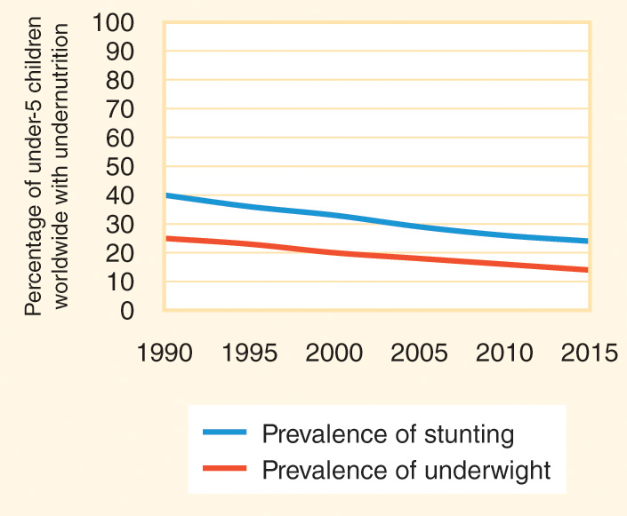
Figure 12-3
Data from UNICEF-WHO-World Bank joint child malnutrition estimates - levels and trends. New York: UNICEF / WHO / World Bank; 2016.
The nutritional status of children less than 5 years old has improved significantly in recent years.

Slide 23
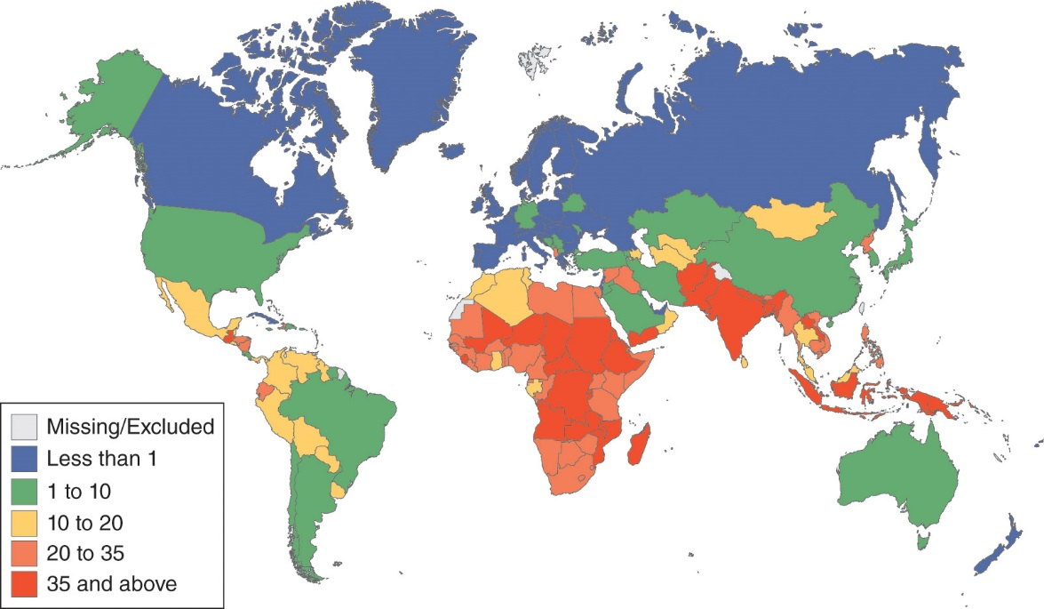
Figure 12-4
Data from World health statistics 2017. Geneva: WHO; 2017.
Prevalence of stunting in children less than 5 years old (2005-2016).

Slide 24
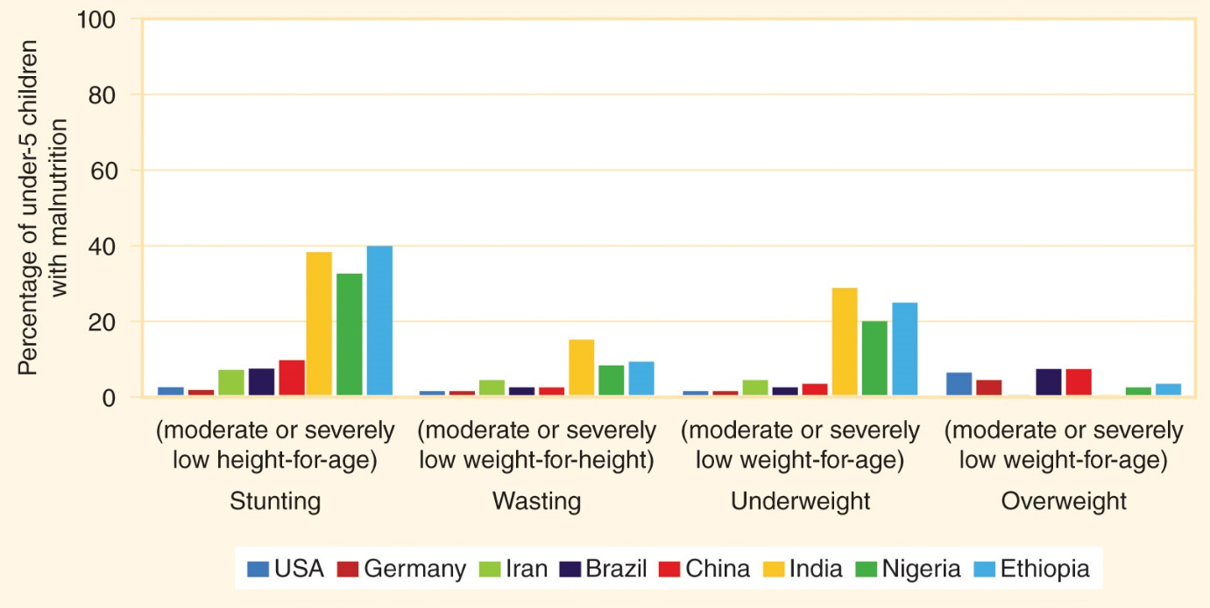
Figure 12-5
Data from The state of the world’s children 2016. New York: UNICEF; 2016.
Percentage of under-5 children (aged 0–59 months) who are more than two standard deviations from the median of the WHO Child Growth Standards.

Slide 25
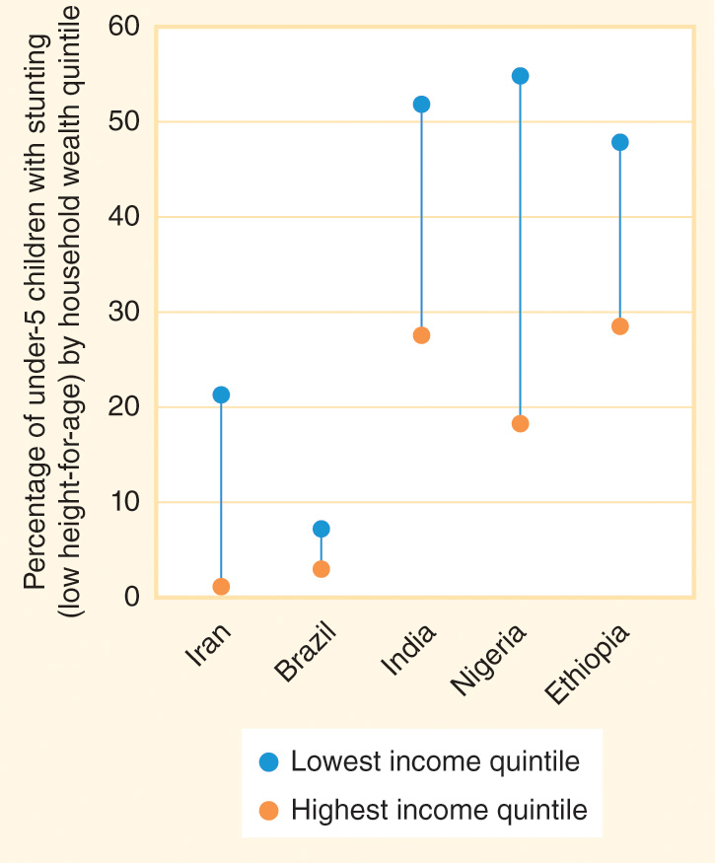
Figure 12-6
Data from The state of the world’s children 2016. New York: UNICEF; 2016.
Children from poorer households have much higher rates of stunting than children in the same country who live in richer households.

Slide 26
Food Security and Food Systems
12.4

Slide 27
Food Security
Food security exists when people always have access to enough food to be healthy, active, and productive.
  Food security is dependent on food being physically available, economically affordable, and nutritionally valuable.
  Food security is about the distribution and affordability of food as much as it is about food production.
In most countries, the number of food calories available has increased over the past few decades and the prevalence of chronic undernourishment is decreasing.

Slide 28
Food Security (cont’d)
Global Hunger Index (GHI) = a metric that estimates the burden from undernutrition in a population, with a focus on young children.
  In low-income countries, there is still a significant burden from hunger.
  Residents of lower-income countries spend a much higher proportion of their incomes on food than people who live in higher-income countries spend.

Slide 29
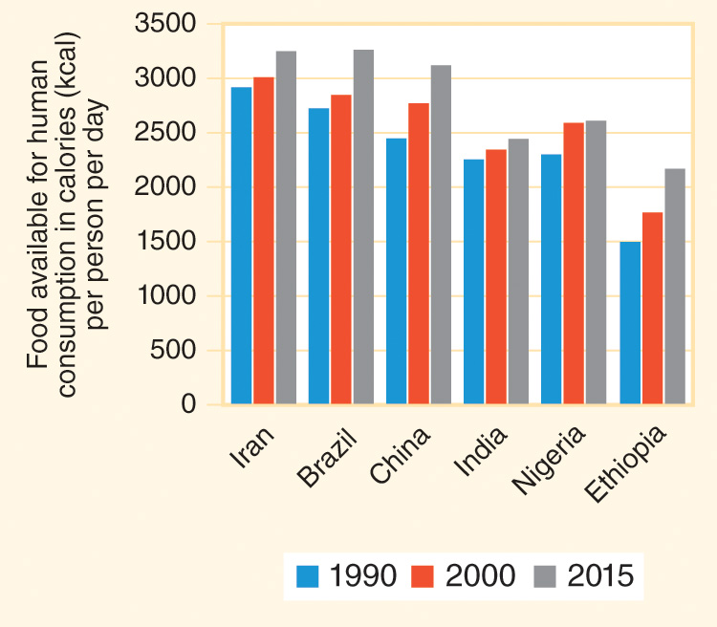
Figure 12-7
Data from FAO statistical pocketbook: World food and agriculture 2015. Rome: FAO; 2015.
The number of daily food calories available for human consumption is increasing. (This figure presents the food available for human consumption after removing non-food use, such as exports, animal feed, and seed.)

Slide 30
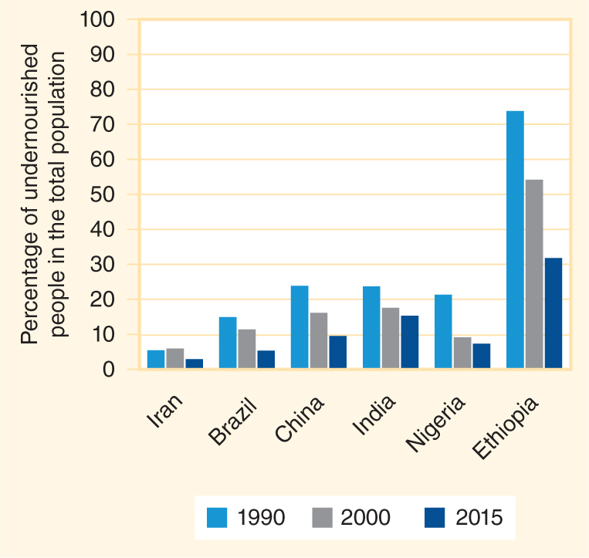
Figure 12-8
Data from The state of food insecurity in the world 2015. Rome: FAO; 2015.
The percentage of the population with chronic food insecurity is decreasing.

Slide 31
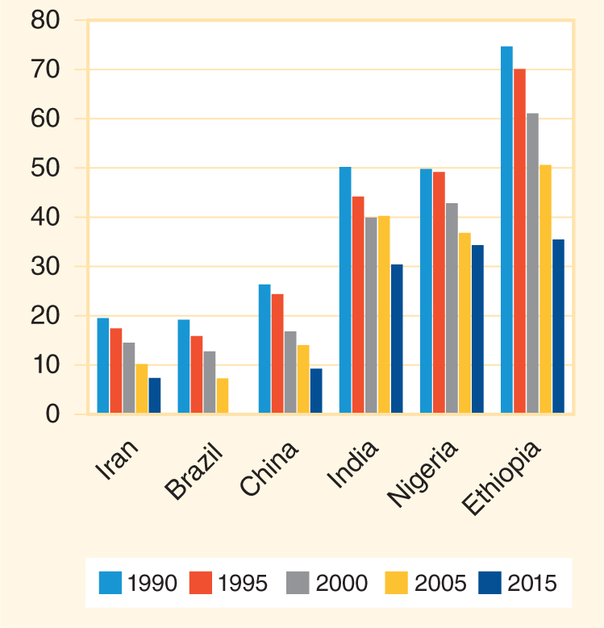
Figure 12-9
Data from 2015 Global Hunger Index: Armed conflict and the challenge of hunger. Bonn: International Food Policy Research Institute (IFPRI); 2015.
The Global Hunger Index has improved in most low- and middle-income countries.

Slide 32
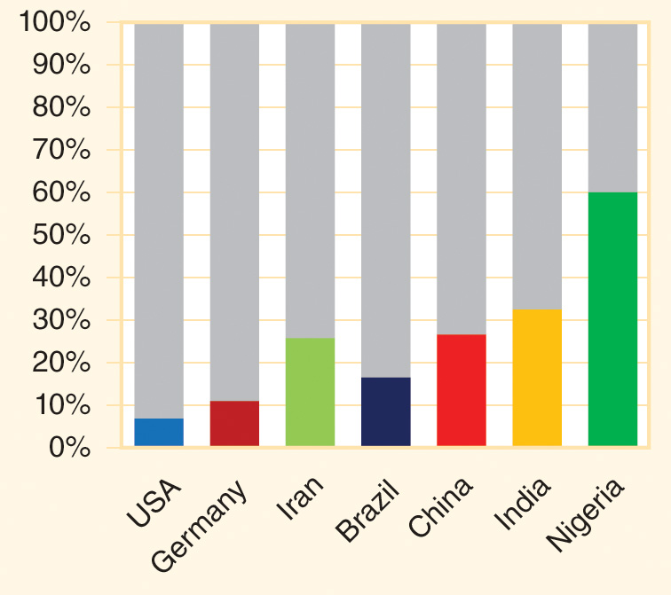
Figure 12-10
Data from Percent of consumer expenditures spent on food, alcoholic beverages, and tobacco that were consumed at home, by selected countries, 2015. Washington: USDA Economic Research Service; 2016.
People in low-income countries spend a high share of their consumer expenditures on food.

Slide 33
Food Insecurity
Most food insecurity is the result of chronic poverty.
  Some households and communities experience seasonal food insecurity as food stocks dwindle prior to a new harvest.
  Chronic food insecurity may lasts for years and spiral into humanitarian catastrophes.
Members of food insecure households may report feeling hungry but not eating, worrying that their food will run out, running out of food and not having enough money to buy more, eating only a limited variety of low-cost foods, cutting the size of meals, skipping meals, and not eating for a whole day.
  Poverty is both a cause of food insecurity and an outcome of it.

Slide 34
Food Insecurity (cont’d)
During times of widespread hunger or famine, a large proportion of a population has very low food security for an extended period of time, often leading to mass migration and death.
  Famines are partially attributable to demographics and environmental factors, but are also due to economic and political situations.

Slide 35
Food Systems
Food system = the entire process of growing or producing food, processing and packaging food, distributing and selling food (which may require transportation and storage), and preparing and consuming food.
Sustainable Development Goal (SDG) 2 aims to “end hunger, achieve food security and improved nutrition, and promote sustainable agriculture,” and the pathways toward ending hunger (SDG 2.1) and undernutrition (SDG 2.2) include increasing the agricultural productivity of small-scale food producers (SDG 2.3) and ensuring that food production systems are sustainable and preserve ecosystem health (SDG 2.4).
The best way to ensure that everyone is food secure is to increase food production while also increasing environmental protection.

Slide 36
Micronutrients
12.5

Slide 37
Micronutrients
Micronutrients = nutrients that the body requires in small amounts.
Vitamins = organic compounds that typically cannot be synthesized by the body.
  Water-soluble vitamins are easily dissolved in the body but are not able to be stored in body tissues so they must be consumed daily for maximum health.
  Fat-soluble vitamins (vitamins A, D, E, and K) are stored in body tissues.
Minerals = inorganic chemical elements.
  Macrominerals (also called major minerals) are needed in relatively large quantities.
  Trace minerals are required in very small amounts.
About 30 vitamins and minerals have been identified as essential components of the human diet.

Slide 38
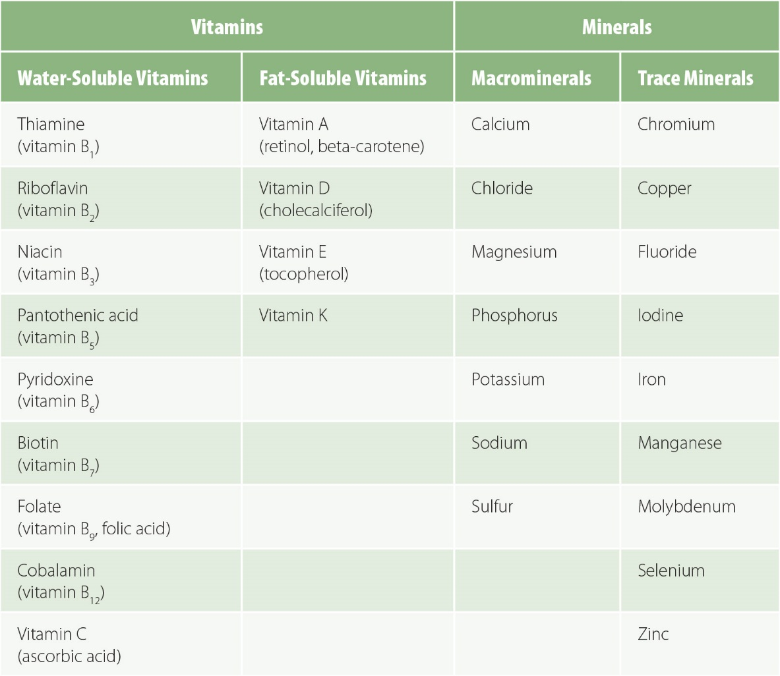
Figure 12-11
Essential vitamins and minerals.

Slide 39
Micronutrient Interventions
The best way to consume micronutrients is through food.
Supplementation = a pill, tablet, or capsule that delivers one or several micronutrients.
Enrichment = the process of adding nutrients lost during handling, processing, or storage back to food products.
Fortification = the process of adding micronutrients not naturally present in a food’s ingredients to a food product.
Bioavailability = the proportion of the nutrient consumed that is able to be absorbed and used by the body.
Vitamin and mineral deficiencies are a common form of “hidden hunger” undernutrition in both children and adults.

Slide 40
Iodine Deficiency Disorders
12.6

Slide 41
Iodine Deficiency Disorders
Iodine = an element that is critical for regulating metabolism, the rate at which a person’s body uses energy.
If there is too little iodine in the diet, the thyroid gland will enlarge as it tries to collect more iodine from the blood, and it will produce a goiter, a swollen neck resulting from an enlarged thyroid gland.
Babies born to mothers who have hypothyroidism may be stillborn or be born with cretinism, brain damage and stunted growth caused by a lack of maternal iodine during fetal development.
Even relatively minor iodine deficiencies may cause impaired mental function in children and adults.

Slide 42
Iodine Deficiency Disorders (cont’d)
Iodine deficiency disorders (IDD) are among the most common causes of impaired cognitive function in the world.
About 30% of the world’s population is estimated to have insufficient iodine intake.

Slide 43
Vitamin A Deficiency
12.7

Slide 44
Vitamin A Deficiency
Vitamin A = a fat-soluble vitamin critical for growth and vision.
Vitamin A deficiency (VAD) is a major cause of preventable blindness in children.
  VAD causes xerophthalmia, a severe dryness of the eye, that progresses to night blindness and eventually the ulceration and scarring of the cornea (keratomalacia).
  VAD increases the risk of death from infectious diseases..
VAD remains one of the most common causes of preventable blindness in children.
  About 30% of children ages 6 to 59 months in low- and middle-income countries are vitamin A deficient.
  Many pregnant women in very low-income countries also have VAD and night blindness.

Slide 45
Vitamin A Deficiency (cont’d)
Dietary prevention of VAD requires a consistent source of both vegetables and oil.
Oil-filled vitamin A capsule supplements are relatively inexpensive and have prevented hundreds of thousands of child deaths and many cases of blindness, but distribution can be a challenge and the benefits of the capsules last for only a few months, so frequent redistribution must occur.

Slide 46
Iron Deficiency Anemia
12.8

Slide 47
Iron Deficiency Anemia
Iron = a mineral the body uses to make the red blood cells (RBCs) that carry oxygen from the lungs to the rest of the cells in the body.
  Hemoglobin = a molecule made from iron that holds the oxygen inside RBCs.
  A person with too little iron is not able to make enough RBCs to efficiently transport oxygen.
Anemia = a deficiency of RBCs or hemoglobin that causes pale skin, fatigue, weakness, shortness of breath, headaches, an increased heart rate, and a limited ability to concentrate at work or school.
Iron deficiency anemia (IDA) = anemia resulting from inadequate iron intake.
Children, pregnant women, and women who menstruate are at high risk for IDA.

Slide 48
IDA Interventions
More than 2 billion people worldwide have IDA, including more than 75 million people with severe anemia.
The prevalence of mild, moderate, and severe anemia has decreased in recent decades from an overall global prevalence of about 40% in 1990 to 33% in 2010.
Even with those improvements, almost 50% of children, 40% of pregnant women, and of 30% non-pregnant women globally are anemic.
IDA can be prevented and treated through increased iron intake.
  Control of infections that cause internal bleeding (like hookworm, whipworm, and schistosomiasis) or destruction of RBCs (like malaria) is also important for preventing and treating IDA.

Slide 49
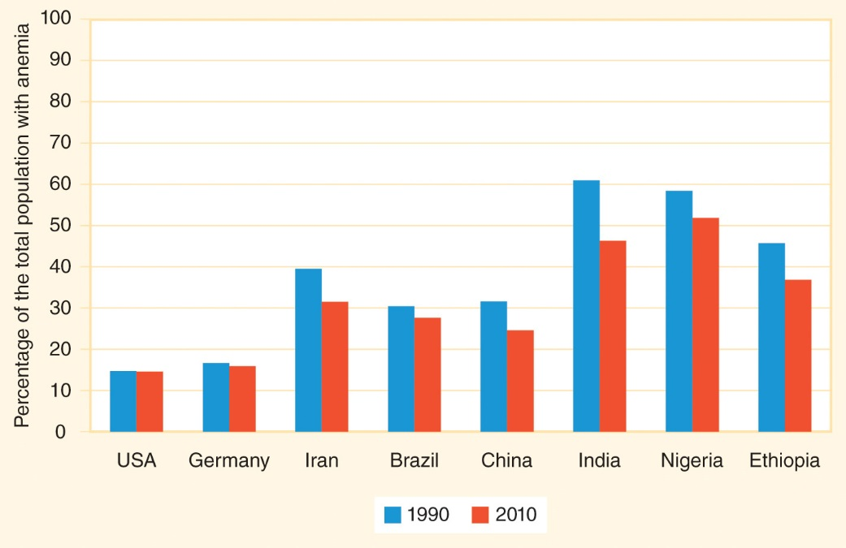
Figure 12-12
Data from Kassebaum NJ, Jasrasaria R, Naghavi M, Wulf SK, Johns N, Lozano R, Ragan M, Weatherall D, Chou DP, Eisele TP, Flaxman SR, Pullan RL, Brooker SJ, Murray CJL. A systematic analysis of global anemia burden from 1990 to 2010. Blood 2014; 123:615-24.
The percentage of the total population with anemia has decreased in many countries.

Slide 50
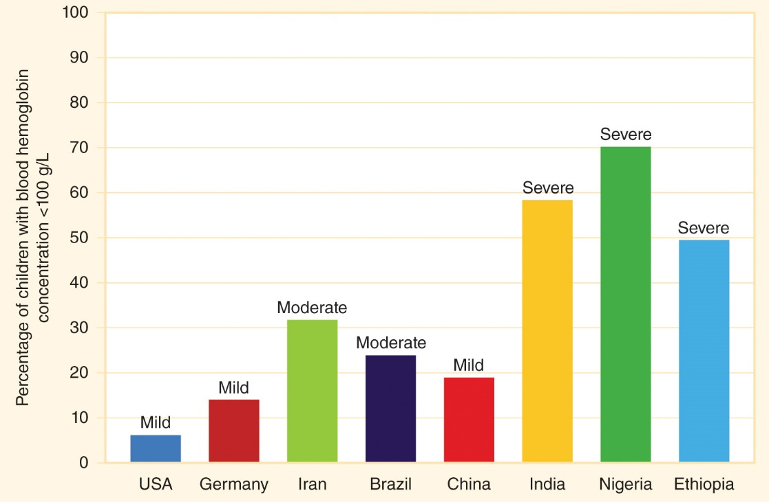
Figure 12-13
Data from The global prevalence of anaemia in 2011. Geneva: WHO; 2015.
Anemia in children aged 6-59 months (blood hemoglobin concentration <100 g/L).

Slide 51
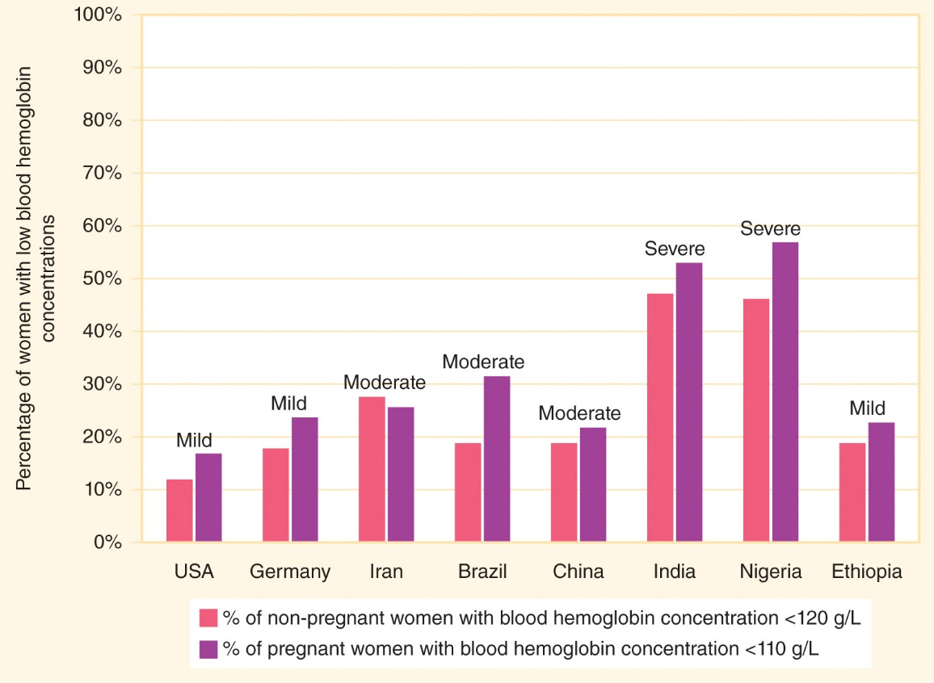
Figure 12-14
Data from The global prevalence of anaemia in 2011. Geneva: WHO; 2015.
Anemia in women aged 15-49 years, by pregnancy status.

Slide 52
Other Micronutrient Deficiencies
12.9

Slide 53
B Vitamins
A serious deficiency of any vitamin or mineral can cause significant impairment of health status.
Thiamine is a B vitamin that is necessary for nerve function.
  Beriberi = thiamine deficiency that causes weakness and heart arrhythmias.
Riboflavin = a B vitamin that contributes to skin and eye health.
Niacin = a B vitamin that is necessary for skin health and for digestive and nervous system function.
  Pellagra = niacin deficiency characterized by dark, peeling skin that sloughs off the body.

Slide 54
B Vitamins (cont’d)
Folate = a B vitamin that is critical for growth, RBC production, and fetal development.
  Folic acid = a synthetic form of folate that can be added to foods or supplements.
  Deficiency during the first weeks of pregnancy is associated with neural tube defects in developing fetuses, such as anencephaly and spina bifida.
  These defects occur very early in the pregnancy, usually before a woman knows she is pregnant, so it is recommended that all women who might become pregnant take a multivitamin.

Slide 55
Other Vitamins
Vitamin C = a vitamin essential for collagen formation, iron absorption, and immune system function.
  Scurvy = vitamin C deficiency characterized by bleeding gums, loose teeth, and joint pain, and decreased immune system function.
Vitamin E is an antioxidant.
Vitamin K is critical for blood clotting.

Slide 56
Minerals
Calcium = a mineral used by the body for strengthening bones and teeth in addition to playing critical roles in muscle and nerve function.
Vitamin D = necessary for bone health, because it assists the body with calcium absorption.
Vitamin D = the “sun vitamin.”
  Rickets = vitamin D deficiency in children whose bones are still growing.
  Osteomalacia = vitamin D deficiency in adults.

Slide 57
Minerals (cont’d)
Fluoride = a mineral that is essential for the development of strong teeth and bones.
Zinc = a mineral that is important for immune function, growth, and child development.
Deficiencies in other minerals can also impair growth, health, and healing.

Slide 58
Breastfeeding
12.10

Slide 59
Breastfeeding
Breastmilk contains all of the nutrients and water babies need, digestive enzymes, and antibodies that protect against harmful infections and promote health.
  Colostrum = the milk produced in the first days after giving birth that contains large quantities of proteins and antibodies.
Recommendation: infants consume only breastmilk during their first 6 months of life and then continue to be nourished by breastmilk after solid foods are introduced into the infant’s diet (up to age 2 years).

Slide 60
Breastfeeding (cont’d)
Early breastfeeding = breastfeeding within the first hours after giving birth.
  Less than half of newborns worldwide receive early breastfeeding within one hour of birth.
Exclusive breastfeeding = breastmilk is the only substance the baby consumes.
  Less than 40% of infants less than 6 months old are exclusively breastfed.
Complementary foods = solid foods that accompany breastmilk and do not immediately replace it.

Slide 61
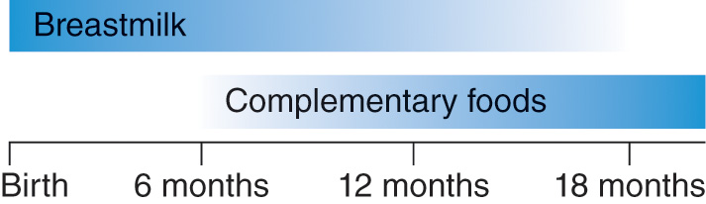
Figure 12-15
Global nutrition standards recommend exclusive breastfeeding for 6 months followed by the introduction of complementary foods with continued breastfeeding.

Slide 62
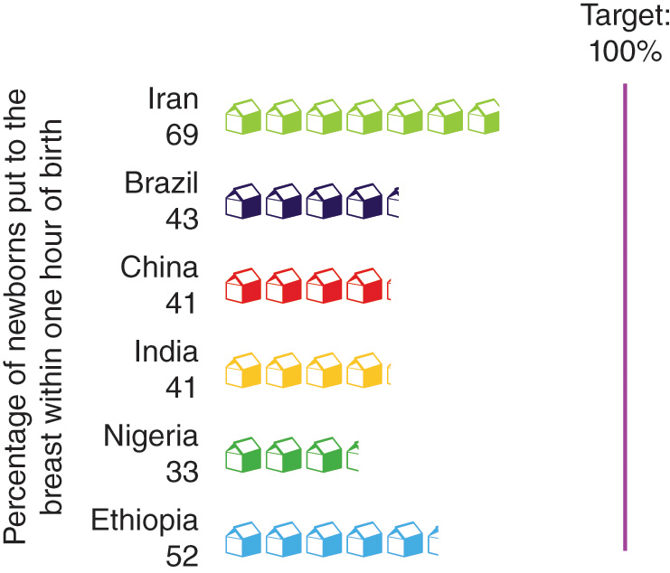
Figure 12-16
Data from The state of the world’s children 2016. New York: UNICEF; 2016.
Early initiation of breastfeeding is low in low- and middle-income countries.

Slide 63
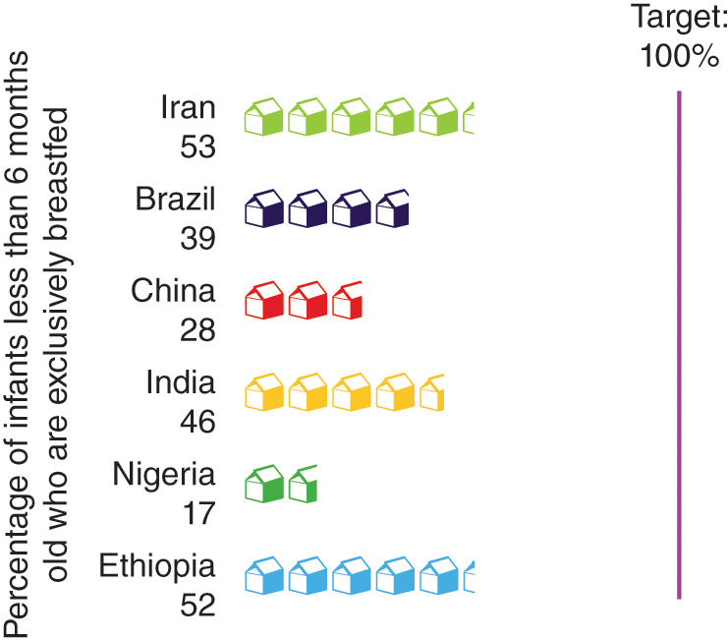
Figure 12-17
Data from The state of the world’s children 2016. New York: UNICEF; 2016.
Few infants are exclusively breastfed in low- and middle-income countries.

Slide 64
Breastfeeding (cont’d)
Commercial infant formula is usually the best substitute for breastmilk for babies whose mothers are not able to exclusively breastfeed.
  Infant formula can be a challenge for mothers and families with a lack of access to clean water, difficulties reading and following the mixing instructions, or limited incomes to pay for commercial products
International Code of Marketing of Breast-milk Substitutes = an international agreement that marketing personnel (even if they are healthcare professionals) should not directly contact pregnant women or new mothers, that health facilities should not promote formula use, and that samples of formula should not be distributed at hospitals or by retailers.
Attitudes toward breastfeeding need to be addressed with grandmothers, employers, and others.

Slide 65
Overweight and Obesity
12.11

Slide 66
Overnutrition
Overnutrition = a form of malnutrition caused by excessive intake of calories and nutrients.
Body mass index (BMI) = a measure of body composition calculated by taking weight in kilograms and dividing it by the square of the height in meters.
International classifications for adults (not children and adolescents):
  Underweight: BMI < 18.5
  Overweight: BMI = 25 to 29.9
  Obese: BMI > 30

Slide 67
Overnutrition (cont’d)
Obesity is associated with an increased risk for many diseases, including type 2 diabetes, hypertension (high blood pressure), heart disease, strokes, gallstones and other digestive disorders, back pain, arthritis of the back and hip, and several types of cancer.

Slide 68
Obesity Epidemiology
More than 2 billion people worldwide are overweight or obese.
Countries with higher average incomes tend to have higher average adult BMIs, but obesity is becoming a public health concern in nearly every region of the world.
  Over the past 25 years, most countries have had steady increases in adult BMIs.

Slide 69
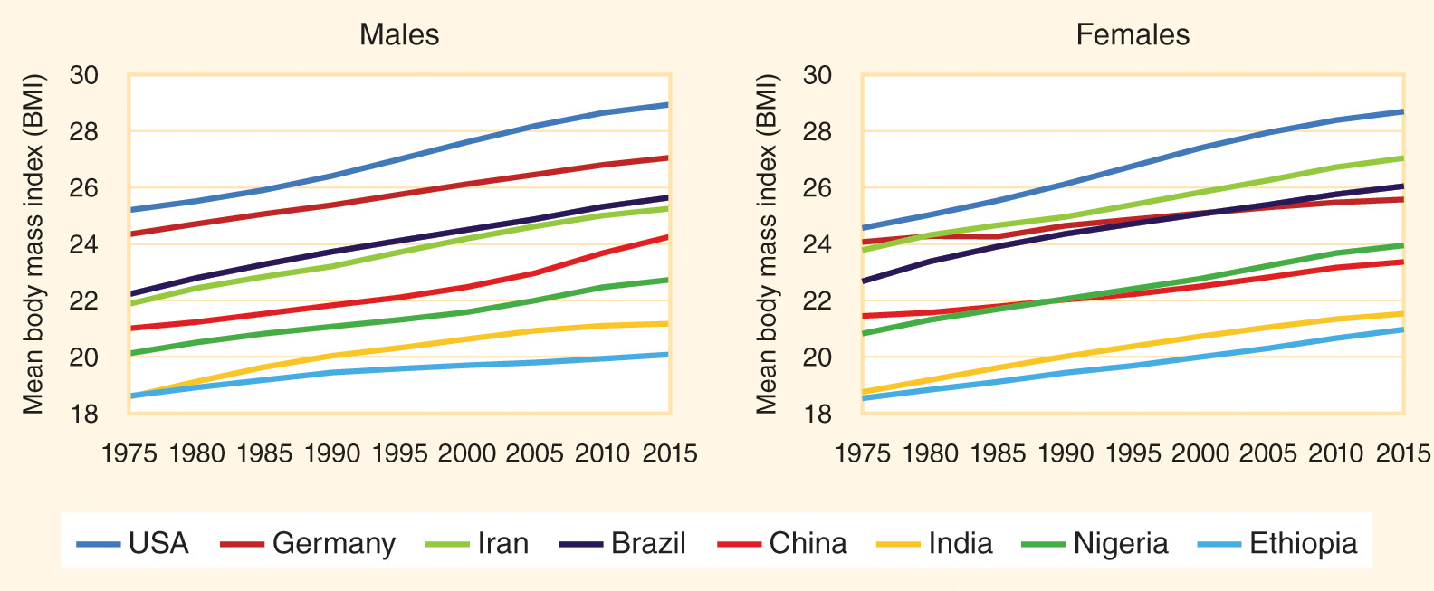
Figure 12-18
Data from NCD Risk Factor Collaboration (NCD-RisC). Trends in adult body-mass index in 200 countries from 1975 to 2014: A pooled analysis of 1698 population-based measurement studies with 19.2 million participants. Lancet 2016; 387:1377-96.
The average adult BMI is steadily increasing in most countries.

Slide 70
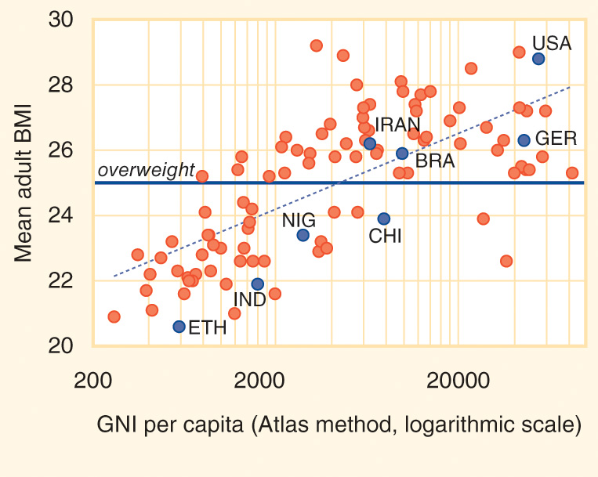
Figure 12-19
Data from Global status report on noncommunicable diseases 2014. Geneva: World Health Organization; 2014.
Higher gross national income per capita is associated with higher average adult higher body mass index (BMI). (The dots represent the 100 most populous countries. Note the use of the logarithmic scale on the x-axis.)

Slide 71
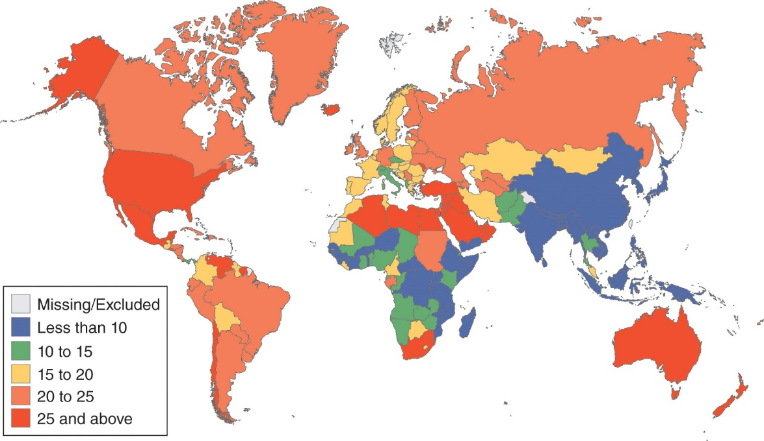
Figure 12-20
Data from GBD 2015 Obesity Collaborators. Health effects of overweight and obesity in 195 countries over 25 years. N Engl J Med 2017; 377:13-27.
Age-standardized percentage of adults (aged 20+ years) who are obese (BMI ≥30) (2015).

Slide 72
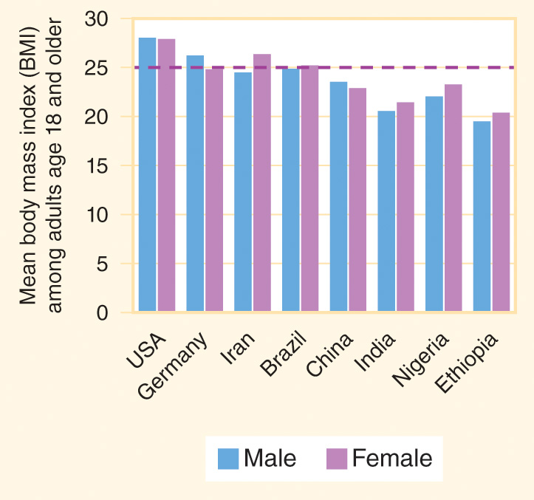
Figure 12-21
Data from NCD Risk Factor Collaboration (NCD-RisC). Trends in adult body-mass index in 200 countries from 1975 to 2014: a pooled analysis of 1698 population-based measurement studies with 19.2 million participants. Lancet 2016; 387:1377-96.
In some countries, the typical adult BMI as above the BMI>25 threshold for being classified as overweight or obese (2015).

Slide 73
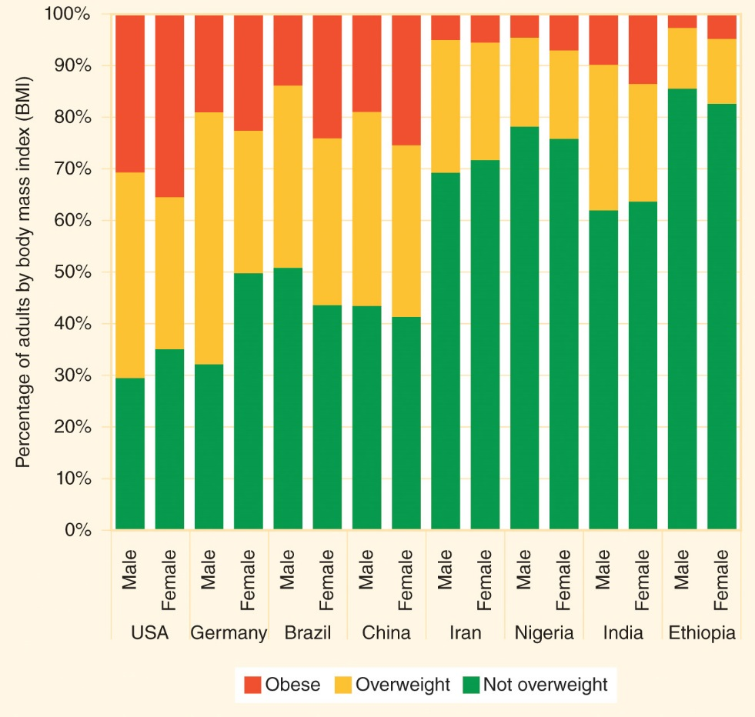
Figure 12-22
Data from GBD 2015 Obesity Collaborators. Health effects of overweight and obesity in 195 countries over 25 years. N Engl J Med 2017; 377:13-27.
Prevalence of overweight and obesity among adults ages 20 and older (2015).

Slide 74
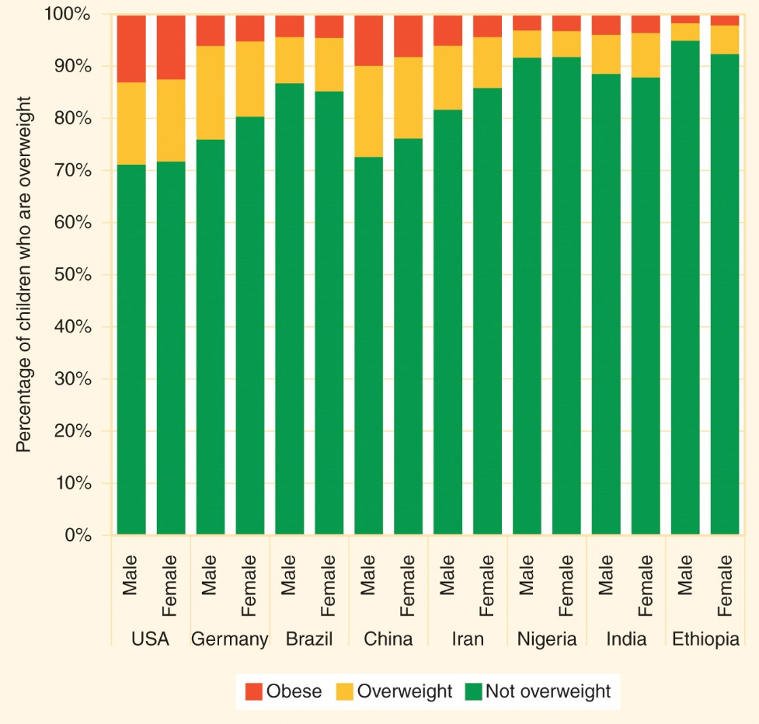
Figure 12-23
Data from GBD 2015 Obesity Collaborators. Health effects of overweight and obesity in 195 countries over 25 years. N Engl J Med 2017; 377:13-27.
Prevalence of overweight and obesity in the pediatric population (ages 2 to 19 years) (2015).

Slide 75
Obesity Epidemiology (cont’d)
The global prevalence of overweight and obesity among adults increased from about 29% in 1980 to about 39% in 2015.
  In many high-income countries and a growing number of middle-income countries, the average BMI among adults is greater than the BMI = 25 threshold for being overweight or obese, and the majority of adults are now overweight or obese.
Overweight and obesity are also becoming more common among children and adolescents.

Slide 76
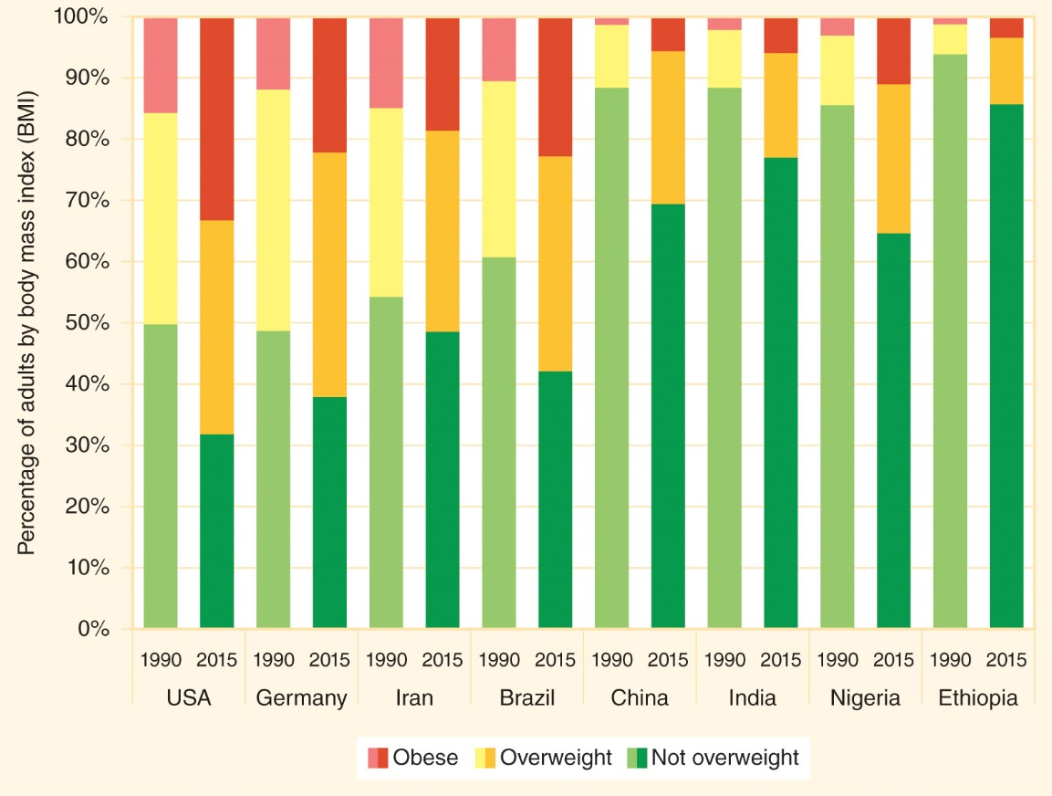
Figure 12-24
Data from GBD 2015 Obesity Collaborators. Health effects of overweight and obesity in 195 countries over 25 years. N Engl J Med 2017; 377:13-27.
The prevalence of overweight and obesity among adults ages 20 and older is increasing.

Slide 77
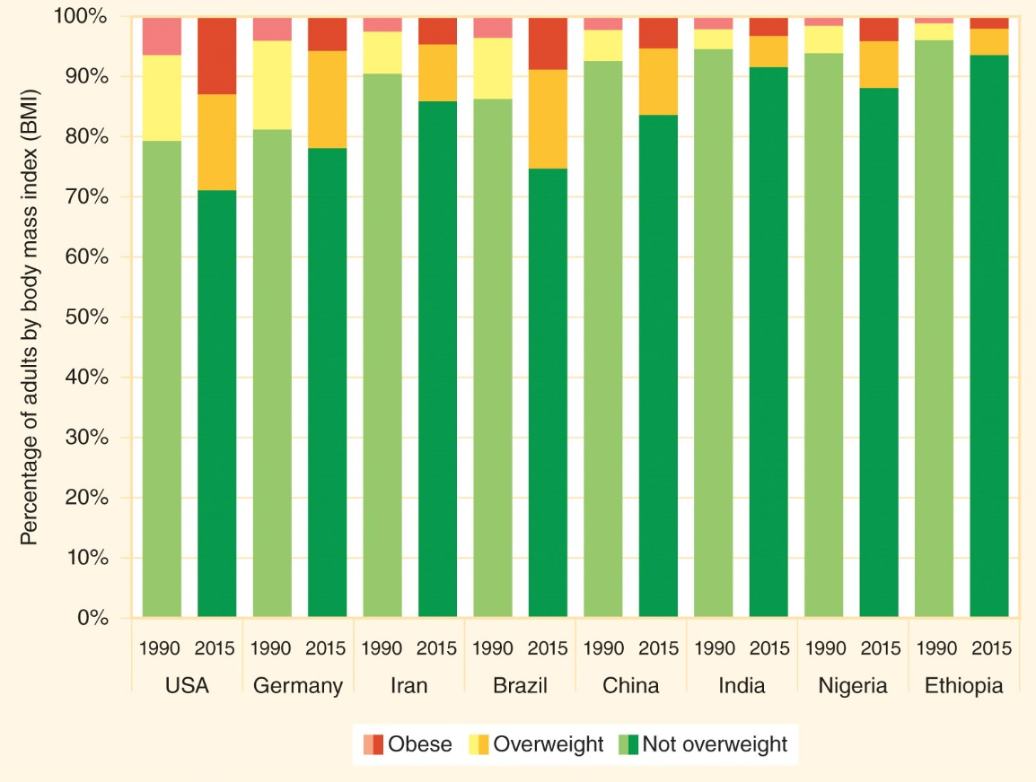
Figure 12-25
Data from GBD 2015 Obesity Collaborators. Health effects of overweight and obesity in 195 countries over 25 years. N Engl J Med 2017; 377:13-27.
The prevalence of overweight and obesity among children ages 2 to 19 is increasing.

Slide 78
Nutrition Transition
Nutritional status is a function of biology and also of psychology and sociology.
Genetic changes do not explain why obesity has become so much more prevalent in recent decades: it takes generations for genetic adaptations to occur, but it takes only a short time to change dietary and exercise habits.
The nutrition transition is also related to a variety of globalization processes, including changing perceptions of beauty.
Policies that promote healthy diets and physical activity may help prevent and reduce obesity.

Slide 79
Food Safety
12.12

Slide 80
Food Safety
International food markets have grown significantly in recent decades.
  The proportion of food consumed in the United States that is imported increased from 12% in 1990 to nearly 20% as of 25 years later.
Increased cross-border trade in foods has created a new set of concerns about food safety.
Because these can be addressed only through international agreements, food safety has become a global health issue.

Slide 81
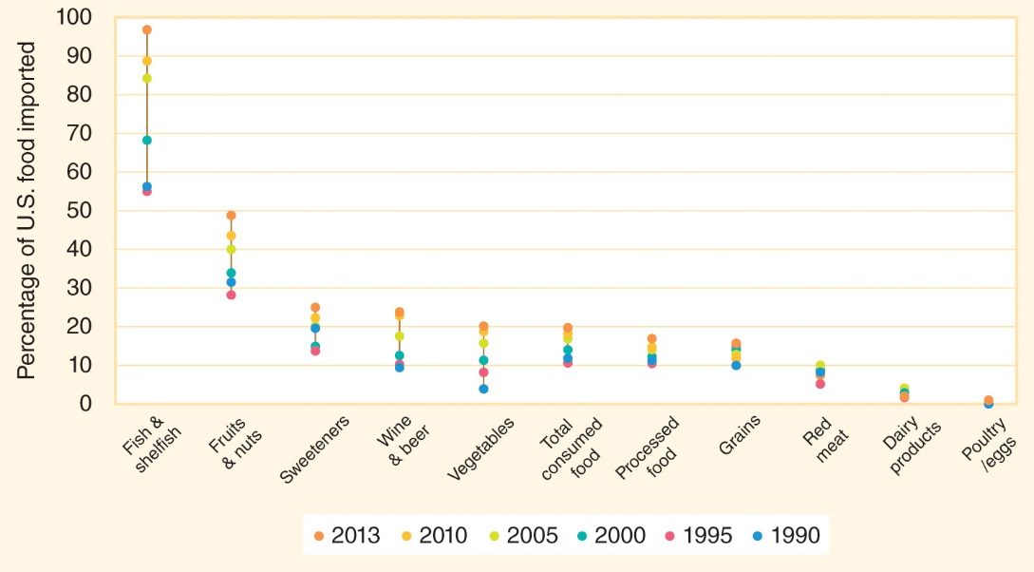
Figure 12-26
Data from Jerardo A. Table 1: Import share of U.S. food consumption. Import share of consumption. Washington: USDA Economic Research Service; 2016.
The percentage of foods consumed in the United States that are imported increased between 1990 and 2015.

Slide 82
Foodborne Diseases
More than 2 billion cases of foodborne diseases and intoxications occur every year.
Foodborne infectious diseases cause more than 1 million deaths each year.
A wide variety of foods have been implicated in outbreaks, and chemical contaminants are increasing threats to health.
  While most outbreaks of foodborne diseases are caused by locally grown and processed foods, an increasing number of large multinational foodborne outbreaks are being reported.

Slide 83
Foodborne Diseases (cont’d)
Food producers, processors, distributors, and consumers all have a role to play in ensuring that foods remain safe along the supply chain.
Codex Alimentarius = international food standards compiled by scientific panels hosted by the United Nations that provide specific guidelines for keeping food products safe.

